Slide 1

WORK INJURY MANAGEMENT
RECORDABILITY INVESTIGATION
EMPLOYER SERVICES
MEDICAL BILL REPRICING
TheWorkforceLLC.com

Slide 2

WORKFORCE
HISTORY
Workforce was established in 1995
For nearly thirty years, Workforce has assisted employers with issues related to the health and safety of their employees
The ultimate goal of Workforce is to develop partnerships with employers and their employees to successfully impact the health and safety issues they both encounter

Slide 3

WORKFORCE
SERVICES
Access Medical Providers for immediate treatment
Assist with Accident Investigation
Arrange post accident Drug Screens and Breath Alcohol Testing
Communicate with Medical Providers at every evaluation
Constantly Coordinates all Communication between employers, employees, TPA / MCO, insurance carriers and medical providers
Arrange telephonic physician consultations
Access and secure current / past medical records / films
Serve as a resource during worker’s compensation litigation
Review medical records to confirm only work injury treatment is billed
Access medical bill review and re-pricing services
Confirm all medical bills are paid to close a case

Slide 4

WORKFORCE
SERVICES
Access provider networks for Medical Cost Savings
Advise employers of Anticipated Medical Outcomes of injuries (surgical intervention / therapy / modified duty work) in order to make the best business decisions
Work with employers to design Transitional Duty jobs to keep injured workers working
Coordinate claims related activity with carrier / TPA & MCO and legal services
Coordinate specialty services, referrals, IMEs, FCEs, surgical consults and second opinion evaluations
Design Comprehensive Job Descriptions
Develop and Create Provider Panels
Create and Maintain Work Injury Files
Participate in Work Site Safety Programs
Coordinate Employment Testing Procedures

Slide 5


WORKFORCE
WORK INJURY MANAGEMENT PROTOCOLS
Workforce Injury Reporting Hours:
24 hours a day
7 days a week
365 days a year

Slide 6


WORKFORCE
WORK INJURY MANAGEMENT PROTOCOLS
WORK INJURY REPORTED
CONTACT WORKFORCE AT YOUR EARLIEST CONVENIENCE
CLAIM SUCCESS STARTS WITH COMMUNICATION AND EARLY INTERVENTION

Slide 7

WORKFORCE
WORK INJURY MANGEMENT PROTOCOLS
TYPES OF WORK-RELATED INJURIES
FIRST AID
URGENT
EMERGENCY

Slide 8
WORKFORCE
WORK INJURY MANGEMENT PROTOCOLS
CLAIM MANAGEMENT LIFECYCLE
FIRST AID LEVEL INJURIES

Slide 9




WORKFORCE
WORK INJURY MANGEMENT PROTOCOLS
CLAIM MANAGEMENT LIFECYCLE FIRST AID INJURIES – PART I
INJURY OCCURS
INJURY REPORTED
TO EMPLOYER
CONTACT
THE WORKFORCE
EMPLOYER REPORTS INJURY TO
ON-SITE NURSE

Slide 10




WORKFORCE
WORK INJURY MANGEMENT PROTOCOLS
CLAIM MANAGEMENT LIFECYCLE FIRST AID INJURIES – PART II
CONTINUE TO MONITOR CLAIM WITH JOBSITE FOREMAN / ON-SITE SAFETY
MONITOR SYMPTOMS / PROGRESS WITH TELEPHONIC NURSE INTERVENTION
WORKFORCE SPEAKS WITH INJURED WORKER
MONITOR SYMPTOMS / PROGRESS WITH TELEPHONIC PHYSICIAN INTERVENTION

Slide 11

WORKFORCE
WORK INJURY MANGEMENT PROTOCOLS
CLAIM MANAGEMENT LIFECYCLE FIRST AID INJURIES – PART III
THE WORKFORCE CONTINUALLY UPDATES CORPORATE OFFICE ON CONDITION & RECOVERY
WORKFORCE CONTINUALLY MONITORS CONDITION & RECOVERY

Slide 12


WORKFORCE
WORK INJURY MANGEMENT PROTOCOLS
CLAIM MANAGEMENT LIFECYCLE FIRST AID INJURIES – PART IV
WORKFORCE CONFIRMS COMPLETE RECOVERY WITH CORPORATE OFFICE
EMPLOYEE / EMPLOYER REPORTS COMPLETE RECOVERY

Slide 13
WORKFORCE
WORK INJURY MANGEMENT PROTOCOLS
CLAIM MANAGEMENT LIFECYCLE
URGENT CARE LEVEL INJURIES

Slide 14
WORKFORCE
WORK INJURY MANGEMENT PROTOCOLS
CLAIM MANAGEMENT LIFECYCLE URGENT CARE INJURIES – PART I
INJURY OCCURS
INJURY REPORTED
TO EMPLOYER
CONTACT
THE WORKFORCE
EMPLOYER REPORTS INJURY TO
ON-SITE NURSE

Slide 15
WORKFORCE
WORK INJURY MANGEMENT PROTOCOLS
CLAIM MANAGEMENT LIFECYCLE URGENT CARE INJURIES – PART II
WORKFORCE REPORTS INJURY TO TELEPHONIC NURSE / PHYSICIAN
WORKFORCE RESEARCHES LOCAL PANEL PROVIDERS FOR BEST PLAN OF CARE
WORKFORCE SPEAKS WITH INJURED WORKER
NURSE / PHYSICIAN SPEAKS TO INJURED WORKER

Slide 16

WORKFORCE
WORK INJURY MANGEMENT PROTOCOLS
CLAIM MANAGEMENT LIFECYCLE URGENT CARE INJURIES – PART III
WORKFORCE UPDATES CORPORATE OFFICE ON PLAN
DECISION MADE ON IF OFF-SITE CARE REQUIRED – IF SO, A PROVIDER IS SELECTED
WORKFORCE COORDINATES APPOINTMENT WITH PROVIDER
PHYSICIAN / NURSE / WORKFORCE DISCUSS TREATMENT DIRECTLY WITH PROVIDER

Slide 17

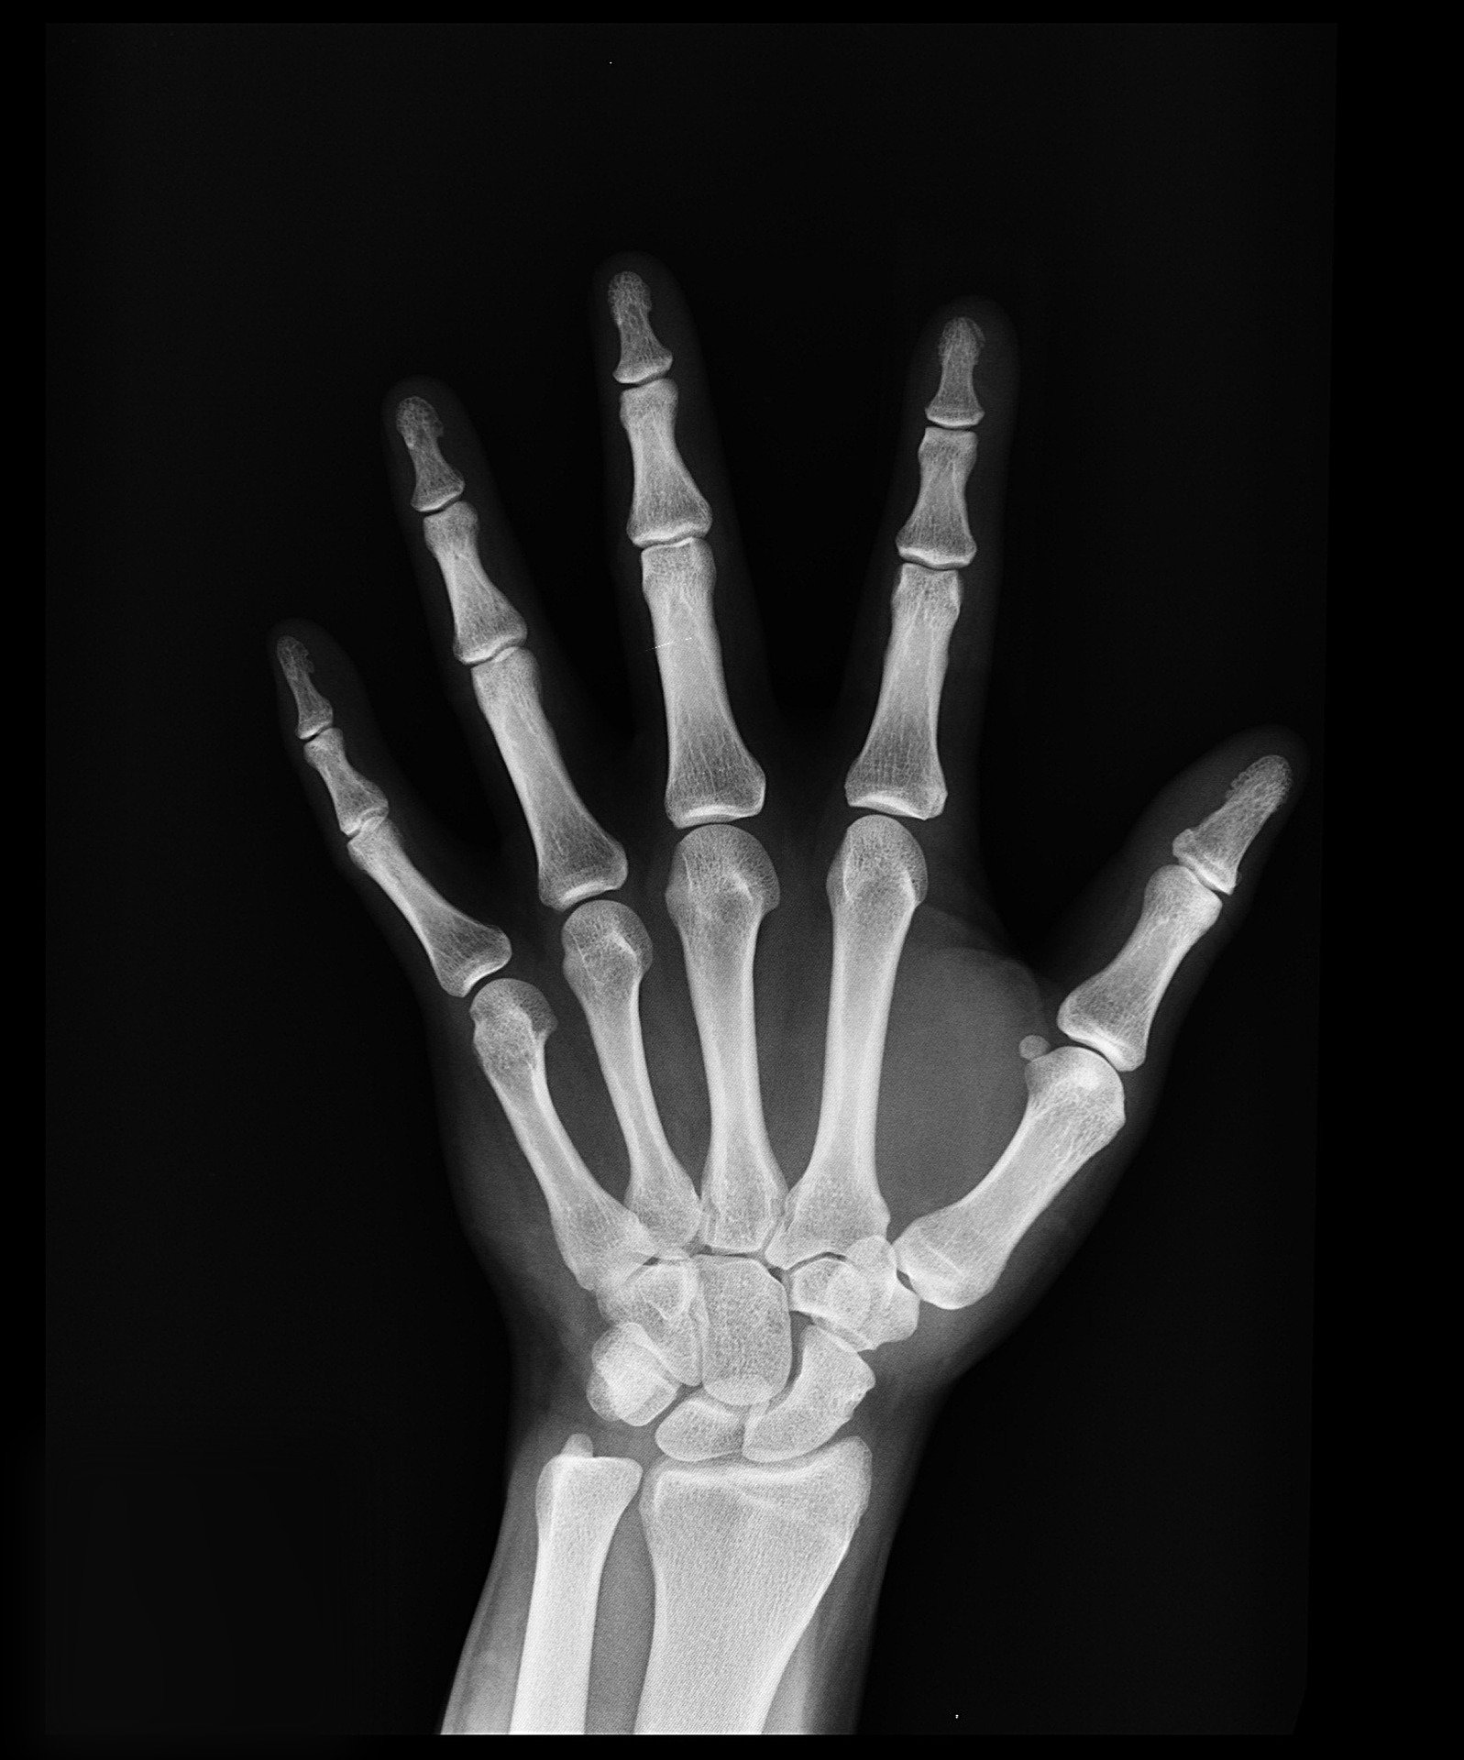

WORKFORCE
WORK INJURY MANGEMENT PROTOCOLS
CLAIM MANAGEMENT LIFECYCLE URGENT CARE INJURIES – PART IV
WORKFORCE SENDS DOCUMENTATION TO EMPLOYER & INSURANCE CARRER, IF NECESSARY
WORKFORCE OBTAINS EXAM FORM FROM PROVIDER
WORKFORCE COORDINATES ALL FOLLOW-UP CARE AND REFERRALS
FOLLOW-UP CARE / SPECIALIST REFERRALS
THERAPY
IMAGING

Slide 18



WORKFORCE
WORK INJURY MANGEMENT PROTOCOLS
CLAIM MANAGEMENT LIFECYCLE URGENT CARE INJURIES – PART V
CASE CLOSES
MEDICALLY
THE WORKFORCE CONFIRMS COMPLETE RECOVERY WITH CORPORATE OFFICE & CARRIER, IF NECESSARY
EMPLOYEE / PHYSICIAN REPORT COMPLETE RECOVERY
SELF-PAY / REPRICE

Slide 19
WORKFORCE
WORK INJURY MANGEMENT PROTOCOLS
CLAIM MANAGEMENT LIFECYCLE
EMERGENCY CARE LEVEL INJURIES

Slide 20


WORKFORCE
WORK INJURY MANGEMENT PROTOCOLS
CLAIM MANAGEMENT LIFECYCLE EMERGENCY INJURIES – PART I
EMPLOYEE / SITUATION STABILIZED
INJURY OCCURS
INJURY REPORTED
TO EMPLOYER
ARRANGE TRANSPORTATION FOR EMPLOYEE
CONTACT
WORKFORCE

Slide 21
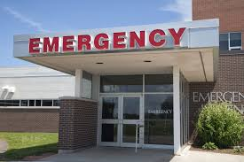
WORKFORCE
WORK INJURY MANGEMENT PROTOCOLS
CLAIM MANAGEMENT LIFECYCLE EMERGENCY INJURIES – PART II
WORKFORCE REPORTS INJURY TO TELEPHONIC NURSE / PHYSICIAN
NURSE / PHYSICIAN SPEAKS TO INJURED WORKER
ONCE STABLE, WORKFORCE SPEAKS WITH INJURED WORKER
NURSE / PHYSICIAN SPEAKS TO TREATING PHYSICIAN

Slide 22
WORKFORCE
WORK INJURY MANGEMENT PROTOCOLS
CLAIM MANAGEMENT LIFECYCLE EMERGENCY INJURIES – PART III
WORKFORCE SENDS DOCUMENTATION TO EMPLOYER & INSURANCE CARRER, IF NECESSARY
WORKFORCE OBTAINS EXAM FORM FROM PROVIDER
WORKFORCE COORDINATES ALL FOLLOW-UP CARE AND REFERRALS
FOLLOW-UP CARE / SPECIALIST REFERRALS
THERAPY
IMAGING

Slide 23
WORKFORCE
WORK INJURY MANGEMENT PROTOCOLS
CLAIM MANAGEMENT LIFECYCLE EMERGENCY INJURIES – PART IV
CASE CLOSES
MEDICALLY
THE WORKFORCE CONFIRMS COMPLETE RECOVERY WITH CORPORATE OFFICE & CARRIER, IF NECESSARY
EMPLOYEE / PHYSICIAN REPORT COMPLETE RECOVERY
SELF-PAY / REPRICE

Slide 24

WORKFORCE
MEDLINK REPRICING DIVISION
MINIMIZE INCIDENT EXPERIENCE AND INJURY FREQUENCY RATE
LESSEN EXPOSRE TO ANNUAL INSURANCE PREMIUM INCREASES
MEDLINK MEDICAL BILL REPRICING CORPORATE PROCESS:
MEDICAL PROVIDERS SEND WORK-RELATED INCIDENT VISIT INVOICES TO MEDLINK
AVOID TURNING SMALL CLAIMS INTO WORKERS COMPENSATION INSURANCE CARRIER
MAINATIN A LOW NUMBER OF REPORTED INJURIES TO CARRIER
LOWER ANNUAL REPORTED INJURY FREQUENCY > LOWER INSURANCE PREMIUM
MEDLINK REPRICES THE AMOUNT OF ORIGINAL INVOICE TO STATE-ALLOWED MAXIMUM
MEDLINK SENDS THE REDUCED, REPRICED INVOICE TO EMPLOYER
EMPLOYER PAYS REDUCED BILL AMOUNT DIRECTLY TO MEDICAL PROVIDER
NO PERCENTAGE OF SAVINGS COLLECTED BY MEDLINK
EMPLOYER SIMPLY PAYS MEDICAL PROVIDER THE REDUCED, REPRICED AMOUNT

Slide 25
WORKFORCE
PERSONAL HEALTH CONDITIONS / WORK CLEARANCES
If an employee arrives to work with a personal health illness/condition that will impact their ability to perform all required essential job duties, contact Workforce immediately for “Return to Work Clearance” assistance
Workforce can assist employers in implementing a policy which states employees off work with personal medical conditions are required to have a “JOB DESCRIPTION” form signed off by their treating physician prior to resuming their job.

Slide 26
WORKFORCE
GETTING STARTED
CONTACT WORKFORCE
CREATE, REVIEW, IMPLEMENT WORK INJURY PROTOCOLS
CREATE PREFERRED PANEL OF MEDICAL PROVIDERS FOR CURRENT JOBSITES/LOCATIONS
NOTIFY INSURANCE CARRIER OF THE WORKFORCE’S INJURY MANAGEMENT ROLE
NO ANNUAL FEE / RETAINER FEE FOR SERVICES
CLIENTS ONLY BILLED FOR WORK COMPLETED ON EACH CASE
WORKING TOGETHER WORKS

